Slide 1



Machine learning in Oil&Gas Industry
Institute of Applied
Mathematics and Mechanics
Andrey Murachev

Slide 2
Day 1: Linear regression and Classification
Day 2: Gradient boosting and Decision trees
Day 3: Neural networks and Kuggle
Notes:
schedule
competition

Slide 3
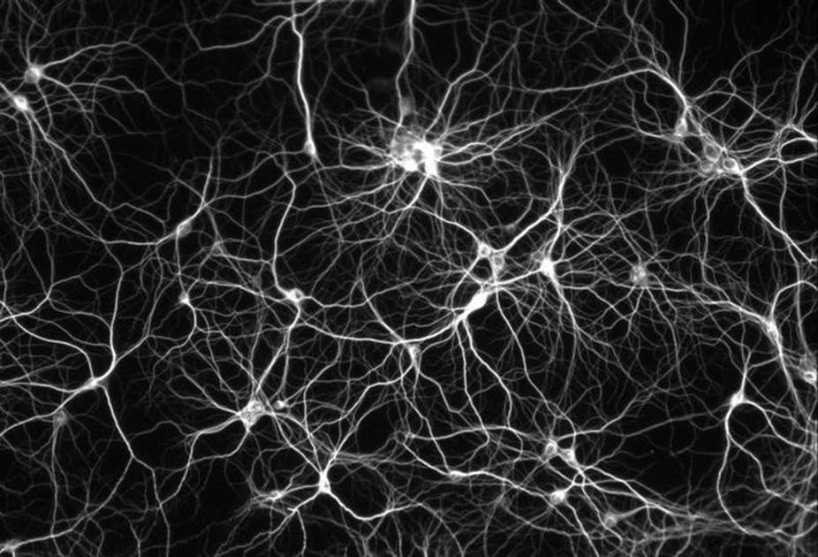
Neural networks

Slide 4
Teaser
A computer calculates faster than man, but it
understands natural language,
recognizes images, recognizes people (ha ha say it to the cops) and
is trained in the broad sense of the word
much worse.
Why? How does a man achieve all this?
Notes:
There is a big mystery in machine learning. At the dawn of machine learning, it seemed that as soon as we teach the machines to calculate, they immediately learn to think, walk and talk themselves. But that did not happen. Why? Why analogy with the animal world does not work? Why is arithmetic so difficult for children, but they so easily recognize patterns and sounds? And why is the recognition task so difficult for machines? For machines that can perform billions of operations per second?

Slide 5
Teaser
Feature-based learning?
• People have tried for many decades to come up with good features:
• MFCC for speech recognition;
• SIFT for image processing;
• ...
Feature engineering task: how to make such features?
But maybe we can find the features automatically? The brain somehow does it.
• But it is difficult!
Notes:
over many decades, people have used different algorithms for different tasks
For this we need to be able to find the features automatically
_----------

Slide 6
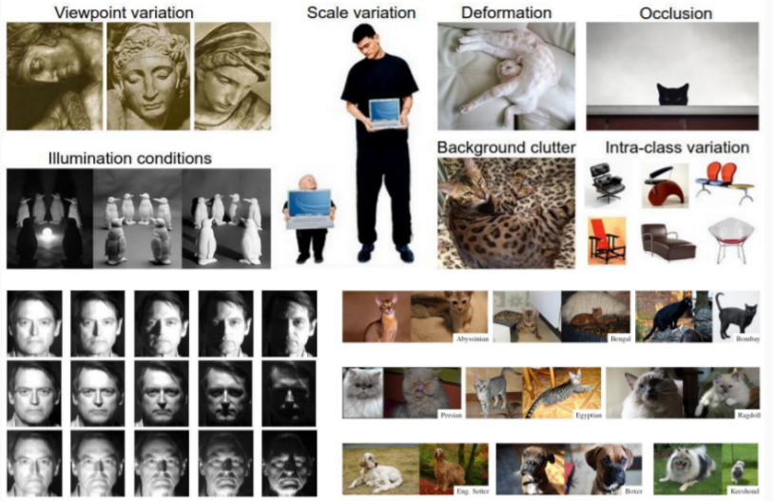
Why it is difficult: image recognition
Notes:
shadow on objects
occlusion ( we can only see part of the object. Everything else is hidden from us)

Slide 7
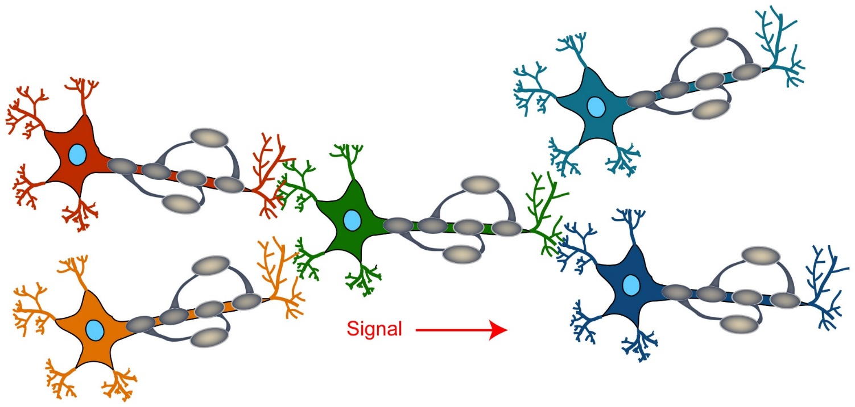
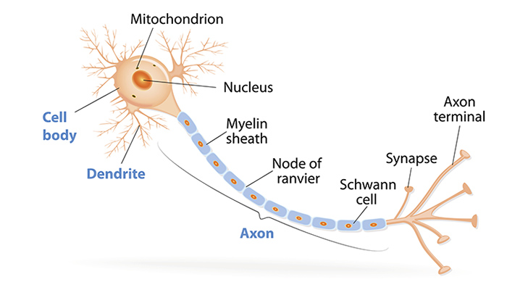
Neurobiology
There are many neurons in the brain; each neuron: • receives a signal from other neurons through dendrites; • from time to time it triggers an axon signal; • the axon signal reaches the dendrites of other neurons through synapses
Notes:
Each neuron in your brain has one long cable that snakes away from the main part of the cell.
This cable, several times thinner than a human hair, is called an axon,
electrical impulses from the neuron travel away t
this electrical impulses are received by other neurons.
Neurons communicate through synapses - contact points between the axon terminals on one side and dendrites or cell bodies on the other.
In a 20-40 nanometre-wide gap, electrical signals coming via the axon are converted into chemical signals through the release of neurotransmitters,
then they promptly converted back into electricity as information moves from neuron to neuron.

Slide 8
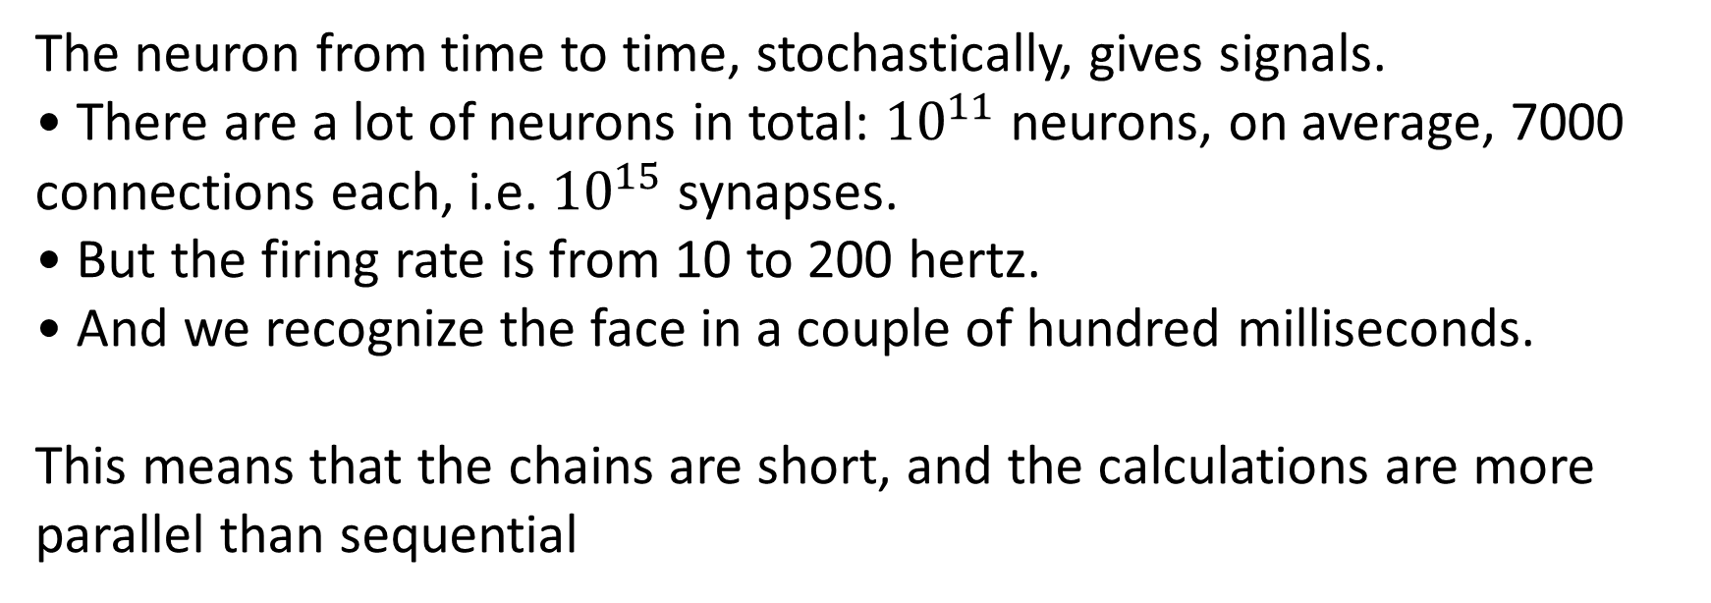
neurobiology
The neuron from time to time, stochastically, gives signals.
• There are a lot of neurons in total: ${10}^{11}$neurons, on average, 7000 connections each, i.e. ${10}^{15}$synapses.
• But the firing rate is from 10 to 200 hertz.
• And we recognize the face in a couple of hundred milliseconds.
This means that the chains are short, and the calculations are more parallel than sequential
Notes:
• The rule of "One hundred steps.
" A person can perform significant tasks in less than a second.
But for half a second, information entering the brain can go through a chain long 100 neurons.
These are not billions of neurons.

Slide 9
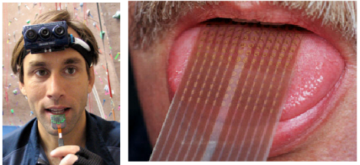
Neurobiology. Brain plasticity
There is a single learning algorithm that can be applied to a variety of situations.
Notes:
The areas of the brain are extremely homogeneous.
Mountcastle (1918-2015) showed that there are no specific differences between different areas of the cortex.
He suggested that since these areas are the same, they perform the same basic operation.
the input is important , not the structure
For the brain, there is nothing but patterns of neuron activity. Brain activity is reduced to spatio-temporal patterns.
The blind man learned to see with the help of the tongue

Slide 10
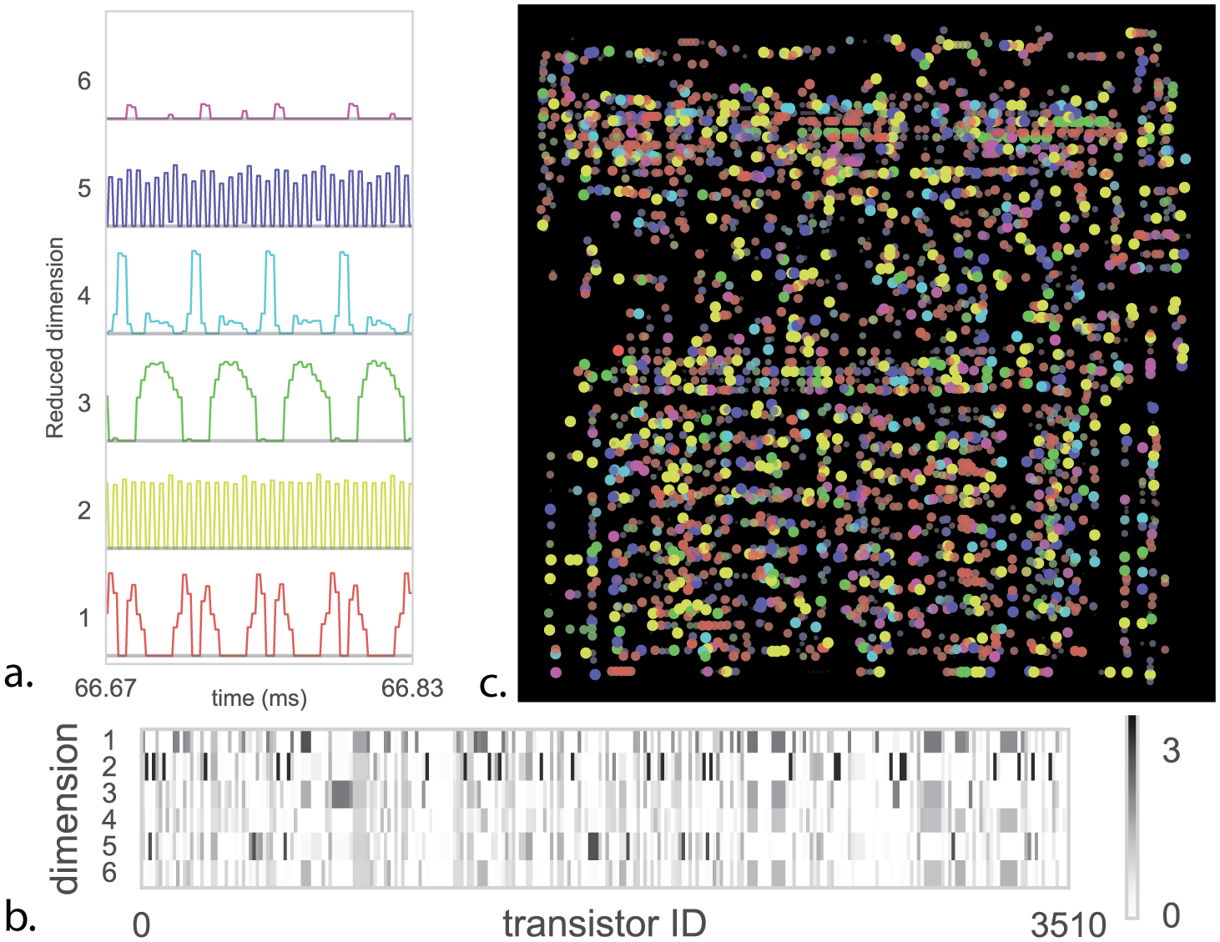
Admonish
2004 - can a biologist fix a radio receiver?
...
2017 - can a neuroscientist understand a microprocessor?
Eric Jonas. Could a Neuroscientist Understand a Microprocessor? PLoS Comput Biol 13(1)
Notes:
At the beginning of the two thousandth

Slide 11
History
First revolution:
Mathematical model of the neuron and the design of an artificial neural network, (Warren McCulloch and Walter Pitts, 1943)
In 1951, Marvin Minsky and his graduate student Dean Edmund built a network of forty synapses. Synapses were randomly connected to each other and trained on the basis of rewards.
1950-… Hubel and Wiesel, studying the visual cortex (motivation for the emergence of convolutional neural networks)
In 1958 Rosenblat creates the model perceptron (one artificial neuron). Then the gradient descent learning algorithm appeared
Notes:
punishment - наказание

Slide 12
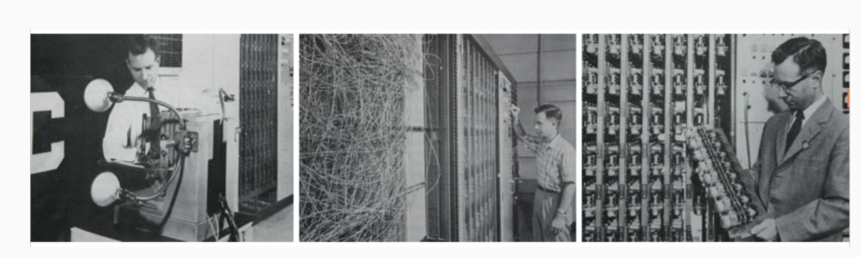
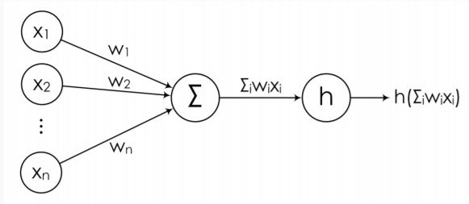
History

Slide 13
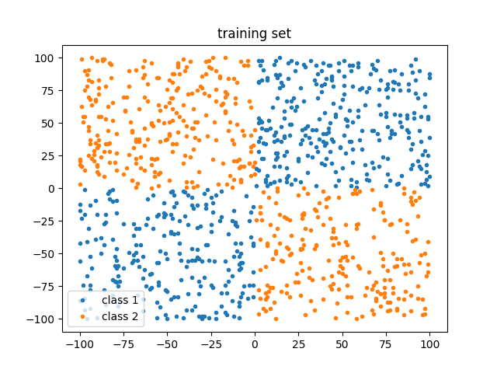

History
Winter in ANN • (Minsky, Papert, 1969): even with nonlinearity, one perceptron defines only a linear dividing surface, XOR cannot be modeled with a perceptron ...
• For some reason, this was perceived as a big problem that puts an end to neural networks.
Notes:
But for some reason, about the obvious decision to make the network deeper, to use a lot of neurons did not speak

Slide 14
History
Second revolution:
• (Brison, Hoback, 1969): proposed backpropagation algorithm • (Hinton, 1974): rediscovered backpropagation, it has since become popular. • In the second half of the 1970s, multi-level ANNs appeared, a modern theory was developed. • Deep models appeared in the first half of the 1980s!

Slide 15
History
Second Winter
But by the early 1990s, it was decided that there was no sense to use neural networks, and the “second winter” began. • It was because then neither mathematically nor computationally could not properly train large models. • It was necessary to train the network for weeks, and the quality lost by other methods. • John Denker, 1994: " neural networks are the second best way to do anything."
• By the end of the 90s, only image processing (Yann LeCun) and several other groups (Geoffrey Hinton, Yoshua Bengio) remained on the neural networks.

Slide 16
History
Third revolution
• The deep learning revolution begins in 2006: Deep Belief Networks (DBN) was invented in the group of Jeffrey Hinton. They learned how to pre train the networks. • Computers have become more powerful, there are ways to transfer calculations to the GPU, and computationally we were able to process much more voluminous datasets that just became available. • And then new regularization methods appeared (dropout, then batch normalization), and RBM with pre-training also became not very necessary.

Slide 17

History
Third winter?
Winter is coming…

Slide 18
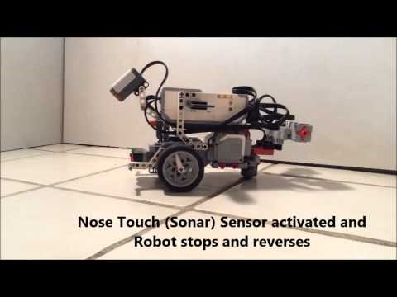
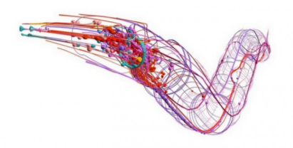
Admonish
We understand little in whole nervous systems:
• Human Brain Project failed;
• were able to create only OpenWorm
(nematode C. elegans, 302 neurons).
Notes:
They wanted to answer the following question: Will we be able to create a system that will demonstrate animal behavior if we copied only the brain structure and neglected the intracellular processes.
We are not at the point yet to answer that question regarding the human brain but by using the well mapped connectome of the nematode (C. Elegans),
They were able to answer this question as a resounding yes, at least in part.
they stimulate specific simulated sensory neurons and muscle excitation using a simple robot (i.e. Lego Mindstorms EV3) and connecting sensors on the robot
It allowes to move a left and right motor on the robot,
We observe worm like behaviors in the robot based purely on environmental factors.

Slide 19
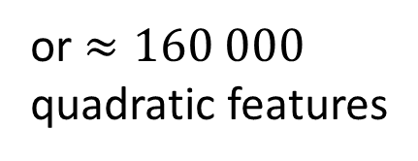
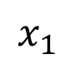

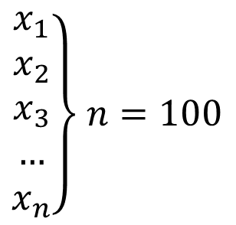
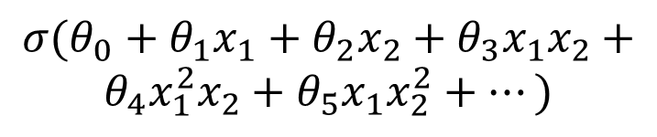
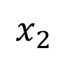
Features are getting bigger
$$σ(θ_{0}+θ_{1}x_{1}+θ_{2}x_{2}+θ_{3}x_{1}x_{2}+$$
$$θ_{4}x_{1}^{2}x_{2}+θ_{5}x_{1}x_{2}^{2}+…)$$
$$x_{2}$$
$\left.\begin{aligned}x_{1} \\ x_{2} \\ x_{3} \\ … \\ x_{n}\end{aligned}\right\}$ $n=100$
we get $≈5 000$
new quadratic features
or $≈160 000$
quadratic features
$$x_{1}$$
Notes:
-----------
The typical approach to machine learning: • build a class of models, usually parametric and tune the parameters so that the model describes the data well;
• that is, we optimize some error function or quality function (likelihood, a posteriori probability).
---------
Neural networks are a very powerful and flexible class of such models. • The difficulty is how to train their parameters

Slide 20
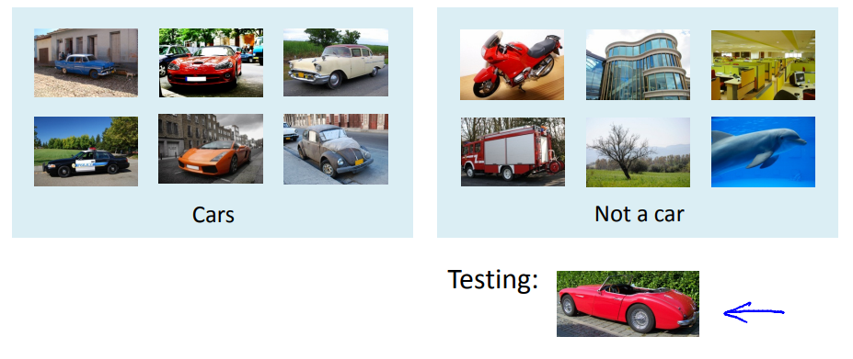
car recognition

Slide 21
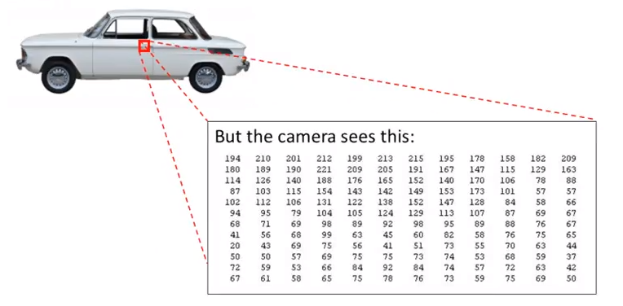
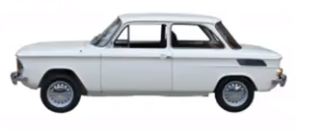
Problem of recognition

Slide 22
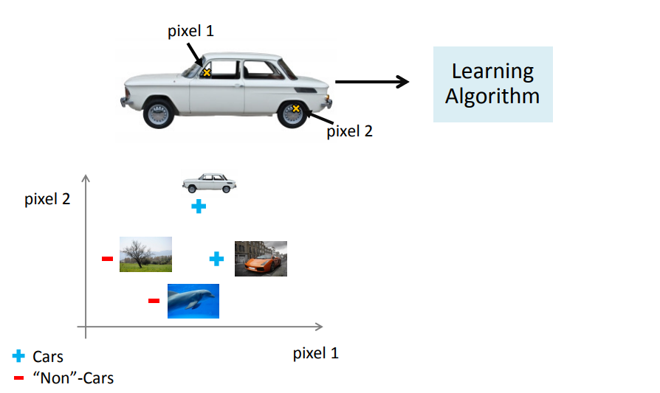
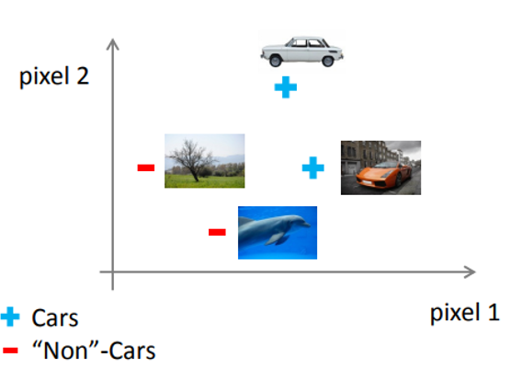
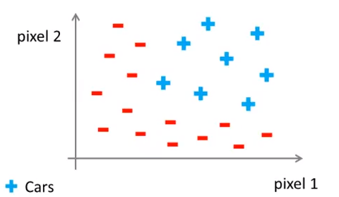
Problem of recognition

Slide 23

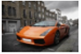
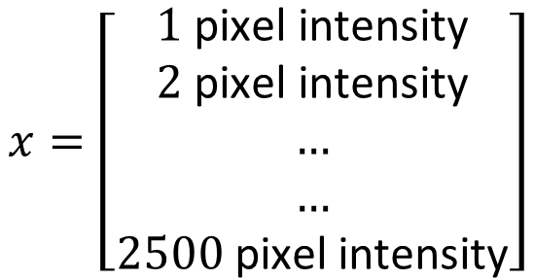
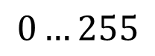
Problem of recognition
50 pxl
2500 pixels, 2500 features! Or 3 million new quadratic features.
50 pxl
$$x=\left[\begin{aligned}1 \text{pixel} \text{intensity} \\ 2 \text{pixel} \text{intensity} \\ … \\ … \\ 2500 \text{pixel} \text{intensity}\end{aligned}\right]$$
$$0…255$$

Slide 24
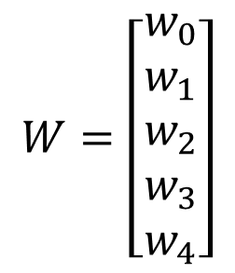
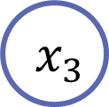
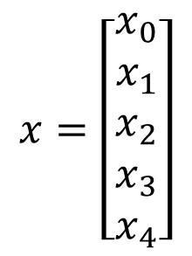
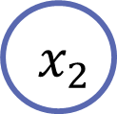
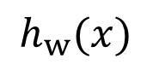
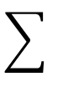

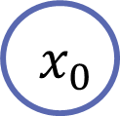
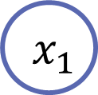
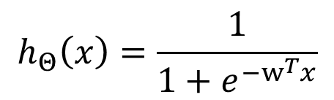
Nonlinear hypothesis. Logistic neuron
$${ x}_{0}$$
Bias
$$x=\left[\begin{aligned}x_{0} \\ x_{1} \\ x_{2} \\ x_{3} \\ x_{4}\end{aligned}\right]$$
$$W=\left[\begin{aligned}w_{0} \\ w_{1} \\ w_{2} \\ w_{3} \\ w_{4}\end{aligned}\right]$$
$${ x}_{1}$$
$$h_{w}(x)$$
$${ x}_{2}$$
Weights
$$h_{Θ}\left(x\right)=\frac{1}{1+e^{−w^{T}x}}$$
$${ x}_{3}$$
The activation function is sigmoid..

Slide 25
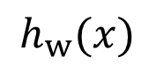
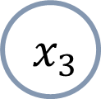
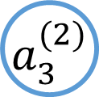
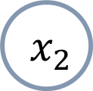
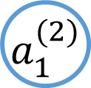
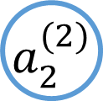
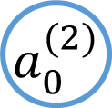
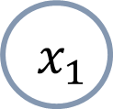
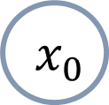
Structure
$${ x}_{0}$$
$${ a}_{0}^{(2)}$$
$${ x}_{1}$$
$${ a}_{1}^{(2)}$$
$$h_{w}(x)$$
$${ x}_{2}$$
$${ a}_{2}^{(2)}$$
$${ x}_{3}$$
$${ a}_{3}^{(2)}$$
Input layer
Hidden layer 1
Output layer

Slide 26
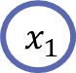
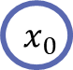
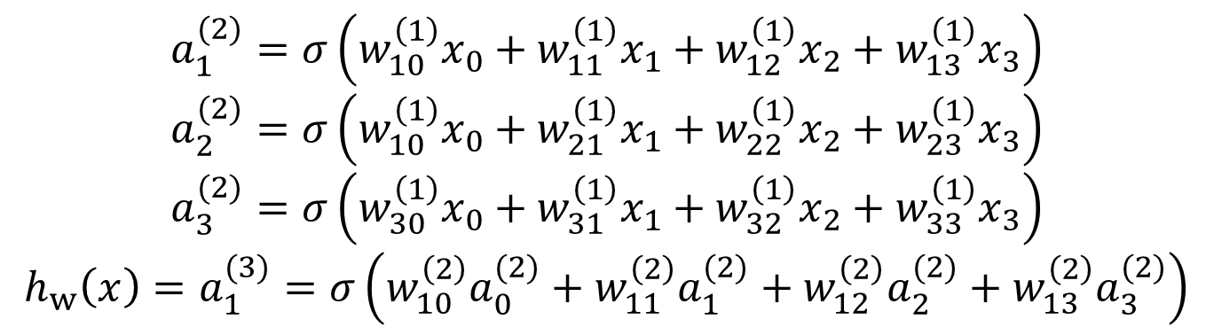
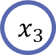
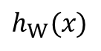
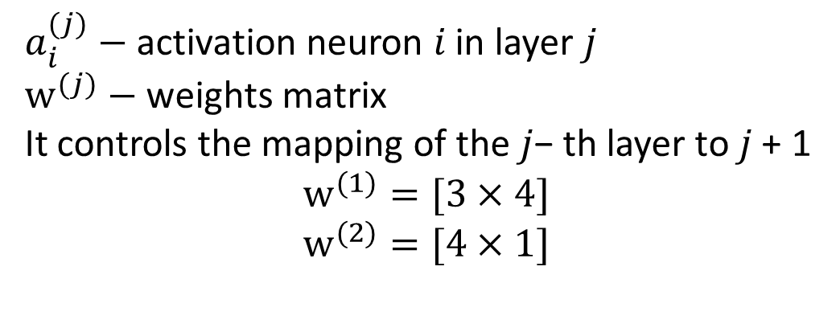







Calculation
$a_{i}^{(j)}−$ activation neuron 𝑖 in layer 𝑗
$w^{(j)}−$ weights matrix It controls the mapping of the 𝑗− th layer to 𝑗 + 1
$$w^{(1)}=[3×4]$$
$$w^{(2)}=[4×1]$$
$${ x}_{0}$$
$$W^{(1)}$$
$${ a}_{0}^{(2)}$$
$$W^{(2)}$$
$${ x}_{1}$$
$${ a}_{1}^{(2)}$$
$$h_{W}(x)$$
$${ x}_{2}$$
$${ a}_{2}^{(2)}$$
$${ x}_{3}$$
$${ a}_{3}^{(2)}$$
$$a_{1}^{(2)}=σ\left(w_{10}^{\left(1\right)}x_{0}+w_{11}^{\left(1\right)}x_{1}+w_{12}^{\left(1\right)}x_{2}+w_{13}^{\left(1\right)}x_{3}\right)$$
$$a_{2}^{(2)}=σ\left(w_{10}^{\left(1\right)}x_{0}+w_{21}^{\left(1\right)}x_{1}+w_{22}^{\left(1\right)}x_{2}+w_{23}^{\left(1\right)}x_{3}\right)$$
$$a_{3}^{(2)}=σ\left(w_{30}^{\left(1\right)}x_{0}+w_{31}^{\left(1\right)}x_{1}+w_{32}^{\left(1\right)}x_{2}+w_{33}^{\left(1\right)}x_{3}\right)$$
$${h_{w}\left(x\right)=a}_{1}^{(3)}=σ\left(w_{10}^{\left(2\right)}a_{0}^{(2)}+w_{11}^{\left(2\right)}a_{1}^{(2)}+w_{12}^{\left(2\right)}a_{2}^{(2)}+w_{13}^{\left(2\right)}a_{3}^{(2)}\right)$$

Slide 27














Vectorization
$$z^{(2)}={(W^{(1)})}^{T} x={(W^{(1)})}^{T}a^{(1)}$$
$$a^{(2)}=σ\left(z^{\left(2\right)}\right)$$
Add bias $a_{0}^{(2)}=1$
$$z^{(3)}={(W^{(2)})}^{T}a^{(2)}$$
$$W^{(1)}$$
$${ x}_{0}$$
$${ a}_{0}^{(2)}$$
$$W^{(2)}$$
$${ x}_{1}$$
$${ a}_{1}^{(2)}$$
$$h_{W}(x)$$
$${ a}_{1}^{(3)}$$
$${ x}_{2}$$
$${ a}_{2}^{(2)}$$
$$a_{1}^{(2)}=σ(z_{1}^{(2)})$$
$$a_{2}^{(2)}=σ(z_{2}^{(2)})$$
$$a_{3}^{(2)}=σ(z_{3}^{(2)})$$
$$h_{W}\left(x\right)=a_{1}^{(3)}=σ\left(z^{(3)}\right)$$
$${ x}_{3}$$
$${ a}_{3}^{(2)}$$

Slide 28

















Example. Logical «And»
$$x_{1}, x_{2}∈\{0,1\}$$
$$x_{2}$$
$$y=1$$
$$+1$$
$$−30$$
$$y=0$$
$$20$$
$$h_{W}(x)$$
$${ x}_{1}$$
$$y=1$$
$$20$$
$$x_{1}$$
$${ x}_{2}$$
$$x_{1}$$ | $$x_{2}$$ | $$h_{W}(x)$$
$$0$$ | $$0$$ | $$σ\left(−30\right)≈0$$
$$0$$ | $$1$$ | $$σ\left(−10\right)≈0$$
$$1$$ | $$0$$ | $$σ\left(−10\right)≈0$$
$$1$$ | $$1$$ | $$σ\left(10\right)≈1$$
$$y=0$$
$$y=0$$

Slide 29




































Example. Logical «XNOR»
$$+1$$
AND
(NOT $x_{1}$) AND (NOT $x_{2}$)
$x_{1}$ OR $x_{2}$
$$−30$$
$$+1$$
$$10$$
$$+1$$
$$10$$
$$20$$
$$h_{σ}(x)$$
$$−20$$
$$h_{σ}(x)$$
$$20$$
$$h_{σ}(x)$$
$${ x}_{1}$$
$${ x}_{1}$$
$${ x}_{1}$$
$$20$$
$$−20$$
$$20$$
$${ x}_{2}$$
$${ x}_{2}$$
$${ x}_{2}$$
$$+1$$
$$y=1$$
$$+1$$
$$a_{1}^{(2)}$$
$$y=0$$
$$x_{1}$$ | $$x_{2}$$ | $$a_{1}$$ | $$a_{2}$$ | $$h_{σ}(x)$$
$$0$$ | $$0$$
$$0$$ | $$1$$
$$1$$ | $$0$$
$$1$$ | $$1$$
$${ x}_{1}$$
$$a_{1}^{(3)}$$
$$y=1$$
$${ x}_{2}$$
$$a_{2}^{(2)}$$
$$x_{1}$$
$$y=0$$

Slide 30







Neural network. Output layer
DataSet: {($x^{\left(1\right)},y^{(1)}$), ($x^{\left(2\right)},y^{(2)}$), … , ($x^{\left(m\right)},y^{(m)}$)}
$L−$ number of neural network layers
$s_{l}−$ number of neurons in the layer $l$ (without bias)
$$(s_{1}=3, s_{2}=5, s_{3}=5, s_{4}=s_{L}=4)$$
Binary classification
Multy-class classification
$y∈\left\{\left[\begin{aligned}1 \\ 0 \\ 0 \\ 0\end{aligned}\right],\left[\begin{aligned}0 \\ 1 \\ 0 \\ 0\end{aligned}\right],\left[\begin{aligned}0 \\ 0 \\ 1 \\ 0\end{aligned}\right],\left[\begin{aligned}0 \\ 0 \\ 0 \\ 1\end{aligned}\right]\right\}, K=4$ outputs
$$y∈\left\{0,1\right\}$$
$$s_{L}=1$$
$$y∈\text{R}$$
$$y∈{\text{R} }^{4}$$
$$s_{L}=K≥3$$

Slide 31

















Cost function
$$J=−\frac{1}{m}\left[\sum_{i=1}^{m}{\sum_{k=1}^{K}{y_{k}^{\left(i\right)}ln\left(h_{W}{\left(x^{\left(i\right)}\right)}_{k}\right)+\left(1−y_{k}^{\left(i\right)}\right)ln\left(1−h_{Θ}{\left(x^{\left(i\right)}\right)}_{k}\right)}}\right]+\frac{λ}{2m}\sum_{l=1}^{L−1}{\sum_{i=1}^{s_{l}}{\sum_{j=1}^{s_{l+1}}{{\left(W_{ij}^{(l)}\right)}^{2}}}}$$
$$\sum_{j=1}^{n}{}$$
$$j$$
$$h_{W}(x)∈{\text{R} }^{K}$$
$h_{W}{\left(x\right)}_{i}−i^{th}$ output
Logistic Regression Cost Function Compilation
Goal: $J\left(W\right)→min$
$${ x}_{1}$$
$$w_{1}$$
Need to calculate :
$J(W)$
$\frac{∂}{∂W^{\left(l\right)}}J\left(W\right)$
$$w_{2}$$
$${ x}_{2}$$
$$h_{W}(x)$$
$$w_{3}$$
$${ x}_{3}$$
$$w_{4}$$
$${ x}_{4}$$
$$K=4, m=3$$

Slide 32















Gradient calculation
for single items$(x,y)$
$$W^{(1)}$$
$$W^{(2)}$$
$${ a}^{(1)}=x$$
$${ a}_{1}^{(2)}$$
$${ x}_{0}$$
$${ a}_{2}^{(2)}$$
$${ a}_{1}^{(3)}$$
$$z^{(2)}=W^{(1)}a^{(1)}$$
$$a^{(2)}=σ\left(z^{\left(2\right)}\right)\left(+ a_{0}^{\left(2\right)}\right)$$
$${ x}_{1}$$
$${ a}_{3}^{(2)}$$
$${ a}^{(1)}$$
$$a^{(2)}$$
$$a^{(3)}$$
$$z^{(3)}=W^{(2)}a^{(2)}$$
$$a^{(4)}= h_{W}(x)=σ\left(z^{\left(3\right)}\right)\left(+ a_{0}^{\left(3\right)}\right)$$
We must find a relationship between changing any element in the weights vector and network error

Slide 33














Backpropagation algorithm
$$δ_{j}^{(L)}=h_{W}(x)−y_{j}$$
$${ a}_{1}^{(2)}$$
$${ δ}_{1}^{(3)}$$
$$δ_{j}^{(l)} − \text{error} \text{of} \text{neuron} \text{j} \text{in} \text{the} \text{layer} \text{l}$$
$${ x}_{0}$$
$$y$$
$${ a}_{2}^{(2)}$$
$${ a}_{1}^{(3)}$$
$${ x}_{1}$$
$$h_{w}(x)$$
$$δ^{(3)}=a^{(3)}−y$$
$${ a}_{3}^{(2)}$$
$$W^{(1)}$$
$$W^{(2)}$$

Slide 34














Backpropagation algorithm
$$W^{(1)}$$
$$W^{(2)}$$
$$J\left(W\right)=\frac{1}{2}{\left(y−h_{W}(x)\right)}^{2}$$
$$\frac{∂}{∂W^{(2)}}J\left(W\right)=−\left(y−a_{1}^{(3)}\right)\frac{∂}{∂W^{\left(2\right)}}a_{1}^{(3)}$$
$$\frac{∂}{∂W^{(2)}}J\left(W\right)=−\left(y−a_{1}^{\left(3\right)}\right)\frac{∂}{∂z^{\left(3\right)}}σ\left(z^{\left(3\right)}\right)\frac{∂z^{\left(3\right)}}{∂W^{\left(2\right)}}$$
$$\frac{∂}{∂W^{(2)}}J\left(W\right)=−\left(y−a_{1}^{(3)}\right)⋅σ^{′}⋅a^{\left(2\right)}=δ^{\left(3\right)}⋅a^{(2)}$$
$$w_{11}^{(2)}$$
$${ a}_{1}^{(2)}$$
$${ x}_{0}$$
$$w_{12}^{(2)}$$
$$δ^{(3)}$$
$${ a}_{2}^{(2)}$$
$$a_{1}^{(3)}$$
$${ x}_{1}$$
$${ a}_{3}^{(2)}$$
$$w_{13}^{(2)}$$
$$δ^{(3)}=−\left(y−h_{Θ}(x)\right)⋅g^{′}$$

Slide 35









Backpropagation algorithm
$$J\left(W\right)=\frac{1}{2}{\left(y−h_{W}(x)\right)}^{2}$$
$$\frac{∂}{∂W^{(1)}}J\left(W\right)=−\left(y−h_{W}(x)\right)\frac{∂}{∂W^{\left(1\right)}}h_{Θ}(x)$$
$$\frac{∂}{∂W^{(1)}}J\left(W\right)=−\left(y−h_{Θ}\left(x\right)\right)\frac{∂}{∂z^{\left(3\right)}}σ\left(z^{\left(3\right)}\right)\frac{∂z^{\left(3\right)}}{∂W^{\left(1\right)}}=−δ^{\left(3\right)}⋅\frac{∂z^{\left(3\right)}}{∂W^{\left(1\right)}}$$
$$\frac{∂}{∂W^{(1)}}J\left(W\right)={−δ}^{\left(3\right)}\frac{∂z^{\left(3\right)}}{∂a^{\left(2\right)}}\frac{∂a^{\left(2\right)}}{∂W^{\left(1\right)}}=−δ^{\left(3\right)}{\left(Θ^{\left(2\right)}\right)}^{T}\frac{∂a^{\left(2\right)}}{∂z^{(2)}}\frac{∂z^{\left(2\right)}}{∂W^{\left(1\right)}}$$
$$\frac{∂}{∂W^{(1)}}J\left(W\right)={−δ}^{\left(3\right)}{\left(Θ^{\left(2\right)}\right)}^{T}σ\left(z^{\left(2\right)}\right)\frac{∂z^{\left(2\right)}}{∂w^{\left(1\right)}}=δ^{\left(2\right)}a^{(1)}$$
$$Θ^{(1)}$$
$$Θ^{(2)}$$
$$θ_{11}^{(2)}$$
$${ a}_{1}^{(2)}$$
$${ x}_{0}$$
$$θ_{12}^{(2)}$$
$$δ^{(3)}$$
$${ a}_{2}^{(2)}$$
$$a_{1}^{(3)}$$
$${ x}_{1}$$
$${ a}_{3}^{(2)}$$
$$θ_{13}^{(2)}$$
$$δ^{(2)}$$
$$δ^{(2)}={−δ}^{\left(3\right)}{\left(Θ^{\left(2\right)}\right)}^{T}g^{′}$$

Slide 36








Backpropagation algorithm
$$δ_{j}^{(4)}=a_{j}^{(4)}−y_{j}$$
$$δ^{(4)}=a^{(4)}−y$$
Item multiplication
$$δ^{(2)}$$
$$δ^{(3)}$$
$$δ^{(4)}$$
$$\left[\begin{matrix}1 & 3 \\ 5 & 7 \\ 3 & 5\end{matrix}\right]∗\left[\begin{matrix}1 \\ 2 \\ 3\end{matrix}\right]=\left[\begin{matrix}1 & 3 \\ 10 & 14 \\ 9 & 15\end{matrix}\right]$$
$$δ^{(3)}={\left(W^{(3)}\right)}^{T }δ^{(4)}∗σ^{′}\left(z^{(3)}\right)$$
$$δ^{(2)}={\left(W^{(2)}\right)}^{T}δ^{(3)}∗σ^{′}\left(z^{(2)}\right)$$
Home work: find the proof
$$σ^{′}=σ⋅(1−σ)$$

Slide 37
Types of learning
Standard learning
We calculate gradient vector using all data
Online learning
We calculate gradient vector using one item
Minibatch learning
We calculate gradient vector using 10-100 items
Notes:
With standard learning, we analyze errors on all data, find the gradient vector, and only after doing a step in the direction of the anti-gradient. This method is very energy-intensive and, moreover, it can sometimes give poor results with an inappropriate selection of initial weights.

Slide 38




Slide 39

Keras
Keras is an open machine learning library, add-on for TensorFlow and Theano. It was planned as part of the main TensorFlow library, but Keras was allocated to a separate add-on, since Keras is an interface rather than an end-to-end machine learning system. Keras provides a higher-level, more intuitive set of abstractions that makes it easy to form neural networks, regardless of the scientific computing library used at the bottom level.
Keras - front-end
TensorFlow- back-end
Notes:
After training the model one or two times, you’ll notice that you keep getting different accuracies. So you’re not quite sure which one is the right one. This introduces the bias variance trade off. In essence, we’re trying to train a model that will be accurate and not have too much variance of accuracy when trained several times.
To solve this problem we use the K-fold cross validation with K equal to 10. This will split the training set into 10 folds. We’ll then train our model on 9 folds and test it on the remaining fold. Since we have 10 folds, we’re going to do this iteratively through 10 combinations. Each iteration will gives us its accuracy. We’ll then find the mean of all accuracies and use that as our model accuracy. We also calculate the variance to ensure that it’s minimal.

Slide 40

Convolutional
neural networks

Slide 41

Why are fully connected neural networks bad for image analysis?
Disadvantages of ANN
A large number of weights (for ex: $28×28$ pix =784 for input, + 2 hidden layers (800,10) = 635200 weights )
Image is represented as 1D array. We lose an information about topology
The principles of CNN
Shared weights
Local perception
Dimension reduction (layer-by-layer resizing of the entrance )
Convolutional neural networks provide partial stability to scale changes, shifts, turns, angle changes and other distortions.
Notes:
A number of founding fathers (Hinton and his followers) recognized that it was still impossible to train a neural network with more than 3 layers using back-propagation and it is unlikely to succeed [1], except for the CNN
The main feature of convolutional neural networks that distinguishes them from all the others is an artificial weight limit that what is provided by the mechanism of shared weight.
As well as layer-by-layer resizing of the entrance and local perception.
Layer-by-side resizing of a feature map is a trick to ensure scale invariance. Local perception is a good idea, but rather old (70s),
then mechanism of shared weights is quite an interesting thing.
When training, the system must be forced to use as few outputs as possible in the process of presenting the input data.
this mean that part of the neurons of some considered layer of the neural network may use the same weights.
Neurons using the same weights are combined into feature maps,
and each neuron of the feature map is associated with a portion of the neurons of the previous layer.
When calculating the network, each neuron performs convolution of a certain area of ​​the previous layer.
The layers of a neural network constructed in this manner are called convolutional layers.

Slide 42


CNN
Every CNN has the following components/layers:
Input image
Convolution layer
Pooling Layer (max pooling or avg pooling)
Flattening
Fully connected Layer

Slide 43

Input layer
Color images or black and white images divided into channels
The input data of each specific pixel value are normalized in the range from 0 to 1
$$f\left(p,min,max\right)=\frac{p−min}{max−min}$$
$f\left(p,min,max\right)−$ normalization function

Slide 44



Convolution
The core is a system of shared weights, it is one of the main features of the convolutional neural network. In a conventional multilayer network there are a lot of connections between neurons, which slows down the detection process very much. In the convolutional network, on the contrary, the total weights reduces the number of connections and allows us to find the same feature throughout the image area.
Notes:
The first layer in a CNN is always a Convolutional Layer. the input to this is a 32 x 32 x 3 array of pixel values.
A convolutional layer is a set of feature maps. each map has a synaptic nucleus (in different sources it is called differently: a scanning nucleus or a filter).
The light blue grid is called the input feature map. A kernel (shaded area) of value slides across the input feature map.
At each location, the product between each element of the kernel and the input element it overlaps is computed and the results are summed up to obtain the output in the current location. The final output of this procedure is a matrix called output feature map (in green).
This procedure can be repeated using different kernels to form as many output feature maps (a.k.a. output channels) as desired.

Slide 45

Convolution
Notes:
the top corner of the kernel for first convolutional is placed outside the image, in this case
padding

Slide 46





Convolution
$$f$$
$$g$$
Notes:
kernel center coincides with upper corner

Slide 47


Convolution Concept
Notes:
Edge detection on an image using convolution. Note how all the edges separating different colours and brightness levels have been identified

Slide 48

Convolution Concept
Notes:
Edge detection on an image using convolution. Note how all the edges separating different colours and brightness levels have been identified

Slide 49

Convolution Concept
Notes:
Edge detection on an image using convolution. Note how all the edges separating different colours and brightness levels have been identified

Slide 50

Convolution Concept
Notes:
Edge detection on an image using convolution. Note how all the edges separating different colours and brightness levels have been identified

Slide 51

Convolution of images
input image
In the place where the yellow spot will be a greater response. This indicates the presence of a sign on the image.
Notes:
However, let’s talk about what this convolution is actually doing from a high level.
Each of these filters can be thought of as feature identifiers.
When I say features, I’m talking about things like straight edges, simple colors, and curves.
The kernel is a filter or a window that slides over the entire area of the previous map and finds certain attributes of objects.
Basically, in the input image, if there is a shape that generally resembles the curve that this filter is representing, then all of the multiplications summed together will result in a large value!

Slide 52



Convolution of images
Notes:
in the second case value is much lower! This is because there wasn’t anything in the image section that responded to the curve detector filter.
Remember, the output of this conv layer is an activation map.
So, in this simple case the activation map will show the areas in which there at mostly likely to be curves in the picture.
This high value means that it is likely that there is some sort of curve in the input volume that caused the filter to activate.
another value in our activation map will be 0 because there wasn’t anything in the input volume that caused the filter to activate
This is just a filter that is going to detect lines that curve to the right.
We can have other filters for lines that curve to the left or for straight edges.
The more filters, the greater the depth of the activation map, and the more information we have about the input volume.

Slide 53



Convolution

Slide 54

Convolution
ConvNetJSdemo: training on CIFAR-10
http://cs.stanford.edu/people/karpathy/convnetjs/demo/cifar10.html

Slide 55



RelU layer
Notes:
The purpose of applying the rectifier (ˈrektəˌfīər) function is to increase the non-linearity in our images.
The fact is that images are naturally non-linear.
When you look at any image, you'll find it contains a lot of non-linear features (e.g. the transition between pixels, the borders, the colors, etc.).
Rectifier breaks linearity. We could create linearity in the image when we missed it through a convolution operation.
To see how this actually happens, we can look at the following picture and see what changes happen to it when it undergoes a convolution operation, followed by correction.

Slide 56

Subsampling
Pooling layers reduce the spatial size of the output by replacing values in the kernel by a function of those values.
E.g. in max pooling, you take the maximum out of every pool (kernel) as the new value for that pool.
Notes:
A pooling or subsampling layer often immediately follows a convolution layer in CNN.
Its role is to downsample the output of a convolution layer along both the spatial dimensions of height and width.
The primary function of a pooling later is to reduce the number of parameters to be learned by the network.

Slide 57


Layers for reshaping input
Earlier
now

Slide 58

Fully connected layer
Notes:
For each neuron (number of neurons = number of outputs), multiply each input by a weight, sum all those products up and then add a bias to get your output for that neuron.

Slide 59

Fully connected layer

Slide 60




Fully connected layer

Slide 61

Localization, Classification, Detection, Segmentation
Object localization
Notes:
we looked at the task of image classification.
This is the process of taking an input image and outputting a class number out of a set of categories.
However, when we take a task like object localization, our job is not only to produce a class label but also a bounding box that describes where the object is in the picture.
We also have the task of object detection, where localization needs to be done on all of the objects in the image.
Therefore, you will have multiple bounding boxes and multiple class labels.
Finally, we also have object segmentation where the task is to output a class label as well as an outline of every object in the input image.

Slide 62

Localization, Classification, Detection, Segmentation
Notes:
we looked at the task of image classification.
This is the process of taking an input image and outputting a class number out of a set of categories.
However, when we take a task like object localization, our job is not only to produce a class label but also a bounding box that describes where the object is in the picture.
We also have the task of object detection, where localization needs to be done on all of the objects in the image.
Therefore, you will have multiple bounding boxes and multiple class labels.
Finally, we also have object segmentation where the task is to output a class label as well as an outline of every object in the input image.

Slide 63

Classification, Localization, Detection, Segmentation
Notes:
we looked at the task of image classification.
This is the process of taking an input image and outputting a class number out of a set of categories.
However, when we take a task like object localization, our job is not only to produce a class label but also a bounding box that describes where the object is in the picture.
We also have the task of object detection, where localization needs to be done on all of the objects in the image.
Therefore, you will have multiple bounding boxes and multiple class labels.
Finally, we also have object segmentation where the task is to output a class label as well as an outline of every object in the input image.

Slide 64

Handling Overfitting
As a general rule: Start by overfitting the model, then take measures against overfitting.
Notes:
How do you know if your model is underfitting? Your model is underfitting if the accuracy on the validation set is higher than the accuracy on the training set. Additionally, if the whole model performs bad this is also called underfitting. For example, using a linear model for image recognition will generally result in an underfitting model.

Slide 65
Handling Overfitting
Add more data
Use data augmentation
Use architectures that generalize well
Add regularization (dropout, vary regularization coefficient or change type regularization)
Reduce architecture complexity.

Slide 66


Data augmentation
Notes:
The first step is of course to collect more data. However, in most cases you will not be able to. Let’s assume you have collected all the data. The next step is data augmentation: something that is always recommended to use.
Data augmentation includes things like randomly rotating the image, zooming in, adding a color filter etc. Data augmentation only happens to the training set and not on the validation/test set. It can be useful to check if you are using too much data augmentation.
For example, if you zoom in so much that features of a cat are not visible anymore, than the model is not going to get better from training on these images. Let’s explore some data augmentation!

Slide 67

Dropout
Notes:
Dropout deletes a random in training.
Be aware that dropout causes information to get lost.
If you lose something in the first layer, it gets lost for the whole network.
Therefore, a good practice is to start with a low dropout in the first layer and then gradually increase it.

Slide 68

Batch normalization
Notes:
Standardizing the inputs we use always in ML.
. Batch normalization takes this a step further. Batch normalization adds a ‘normalization layer’ after each convolutional layer. This allows the model to converge much faster in training and therefore also allows you to use higher learning rates.

Slide 69


pre-trained nets
Pre-trained part VGG 16 (University of Oxford)
Trained part
14 million images
1000 classes.
Notes:
VGG16 is a convolutional neural network model proposed by K. Simonyan and A. Zisserman from the University of Oxford in the article “Very Deep Convolutional Networks for Large-Scale Image Recognition”. The model achieves an accuracy of 92.7% - top-5, when tested on ImageNet in the task of recognizing objects in an image. This dataset consists of more than 14 million images belonging to 1000 classes.
VGG16 is one of the most famous models sent to the ILSVRC-2014 competition. The VGG16 network has been trained for several weeks using NVIDIA TITAN BLACK video cards.

Slide 70

TGS Salt Identification Challenge
Notes:
Machine learning enables us to build complex models on the data collected, leading to better decisions.
In the simplest terms, it is a form of artificial intelligence (AI) which is designed to learn on its own or become better as it is fed more data. These algorithms have the potential to revolutionize our workflow in the future when the applicability of AI increases. However, some machine learning algorithms can be easily incorporated into our workflow today to provide added value.
Effective application of machine learning to solve real-world problems in our industry is becoming a reality thanks to the availability of computational power, advances in algorithms, effective collection of data, complexity of problems, and digitalization efforts.

Slide 71

Drilling: Coupling Downhole Parameters
Notes:
Seismic data is a neat thing. You can imagine it like an ultra-sound of the subsurface. However, in an ultra-sound, we use much smaller wavelengths to image our body. Seismic data usually has wavelengths around 1m to 100m.
Imaging salt has been a huge topic in the seismic industry, basically since they imaged salt the first time. The Society of Exploration geophysicist alone has over 10,000 publications with the keyword salt. Salt bodies are important for the hydrocarbon industry, as they usually form nice oil traps. So there's a clear motivation to delineate salt bodies in the subsurface. If you would like to do a deep dive, you can see this publication
Seismic data interpreters are used to interpreting on 2D or 3D images that have been heavily processed.
Recently, geoscience has started to adopt deep learning, and it has seen a clear boom, particularly in imaging salt.

Slide 72

Notes:
We have many examples without salt, as you can see by the masks that are entirely dark.

Slide 73

U-Net is a convolutional neural network that was developed for biomedical image segmentation at the Computer Science Department of the University of Freiburg, Germany. The network is based on the fully convolutional network and its architecture was modified and extended to work with fewer training images and to yield more precise segmentations.

Slide 74

Drilling: Coupling Downhole Parameters
Models for ROP, torque on bit (TOB), MSE, and stick-slip are built using a data-driven modeling approach using the Random Forests algorithm.
ROP increased by 31% and MSE decreased by 49% on average with the use of this optimization model.
Notes:
machine learning is using to develop an end-to-end coupled drilling optimization advisor.
Most optimization strategies rarely include the effect of vibrations, which is the biggest rate of penetration (ROP) inhibitor.
As such, most optimization studies have attempted to optimize only one drilling metric – ROP, mechanical specific energy (MSE), or vibrations – independent of the other, despite their interaction downhole.
This research introduces a method of coupling several downhole parameters using machine learning algorithms.
Models for ROP, torque on bit (TOB), MSE, and stick-slip are built using a data-driven modeling approach using the Random Forests algorithm.
The models are coupled by building them conjointly during training.
The coupled model was evaluated to optimize ROP and MSE on validation data. ROP increased by 31% and MSE decreased by 49% on average with the use of this optimization model. The model can be used as a real-time drilling advisory system and provide heat maps which can help guide the driller.

